Slide 1

Lecture 1:
Circuits & Layout

Slide 2
Outline
A Brief History
CMOS Gate Design
Pass Transistors
CMOS Latches & Flip-Flops
Standard Cell Layouts
Stick Diagrams

Slide 3
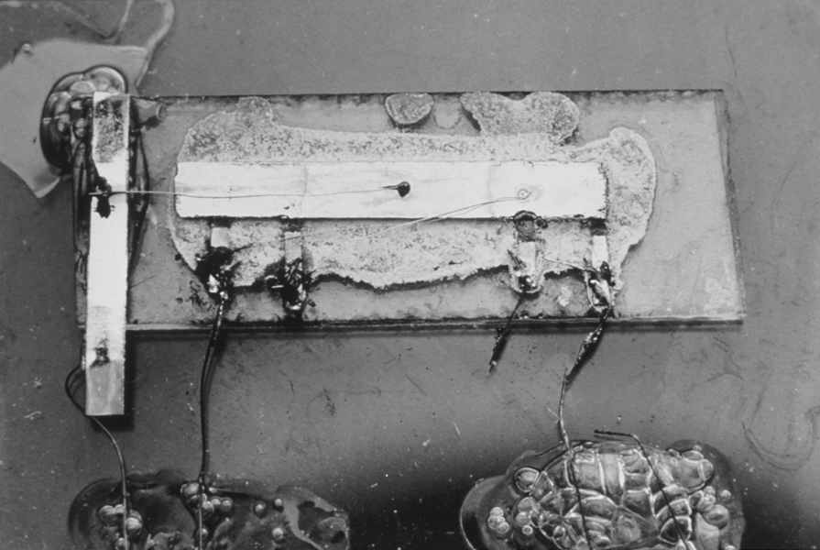
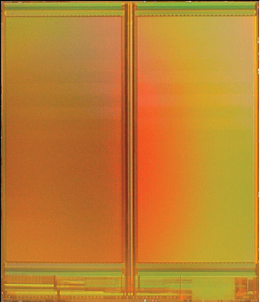
A Brief History
1958: First integrated circuit
  Flip-flop using two transistors
  Built by Jack Kilby at Texas Instruments
2010
  Intel Core i7 μprocessor
    2.3 billion transistors
  64 Gb Flash memory
    > 16 billion transistors
Courtesy Texas Instruments
[Trinh09]
© 2009 IEEE

Slide 4
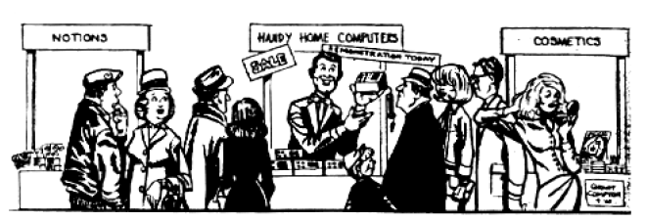
Growth Rate
53% compound annual growth rate over 50 years
  No other technology has grown so fast so long
Driven by miniaturization of transistors
  Smaller is cheaper, faster, lower in power!
  Revolutionary effects on society
[Moore65]
Electronics Magazine

Slide 5
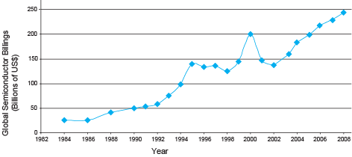
Annual Sales
>10¹⁹ transistors manufactured in 2008
  1 billion for every human on the planet

Slide 6
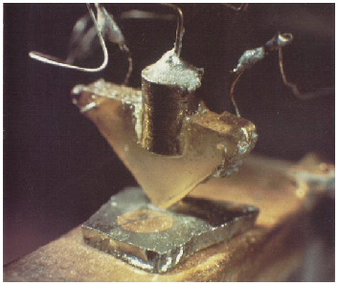
Invention of the Transistor
Vacuum tubes ruled in first half of 20th century Large, expensive, power-hungry, unreliable
1947: first point contact transistor
  John Bardeen and Walter Brattain at Bell Labs
  See Crystal Fire
  by Riordan, Hoddeson
AT&T Archives. Reprinted with permission.

Slide 7
Transistor Types
Bipolar transistors
  npn or pnp silicon structure
  Small current into very thin base layer controls large currents between emitter and collector
  Base currents limit integration density
Metal Oxide Semiconductor Field Effect Transistors
  nMOS and pMOS MOSFETS
  Voltage applied to insulated gate controls current between source and drain
  Low power allows very high integration

Slide 8
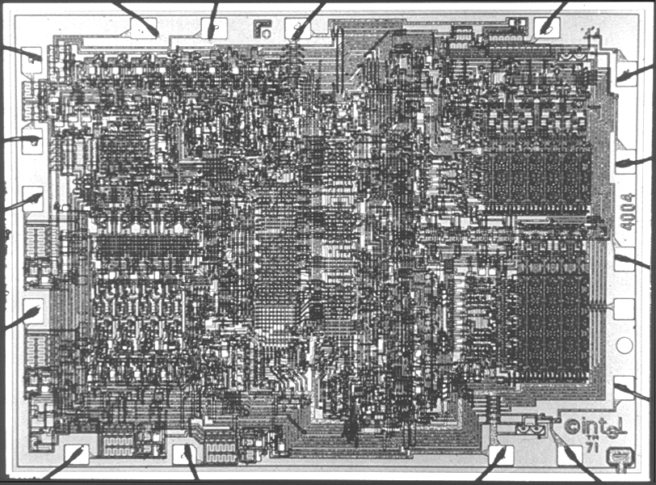
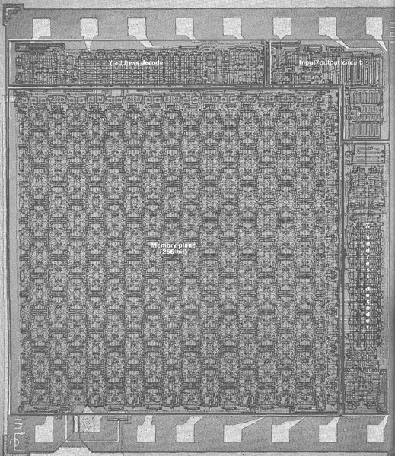
MOS Integrated Circuits
1970’s processes usually had only nMOS transistors
  Inexpensive, but consume power while idle
1980s-present: CMOS processes for low idle power
Intel Museum.
Reprinted with permission.
[Vadasz69]
© 1969 IEEE.
Intel 1101 256-bit SRAM
Intel 4004 4-bit μProc

Slide 9
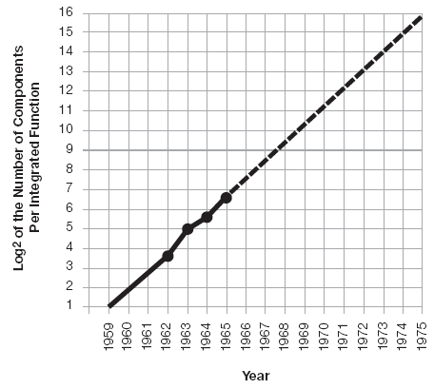
Moore’s Law: Then
1965: Gordon Moore plotted transistor on each chip
  Fit straight line on semilog scale
  Transistor counts have doubled every 26 months
Integration Levels
SSI: 10 gates
MSI: 1000 gates
LSI: 10,000 gates
VLSI: > 10k gates
[Moore65]
Electronics Magazine
Notes:
In 1965, Gordon Moore observed that plotting the number of transistors that can be most ECONOMICALLY manufactured on chip gives a straight line on a semilogarithmic scale . He found transistor count doubling every 18 months.

Slide 10
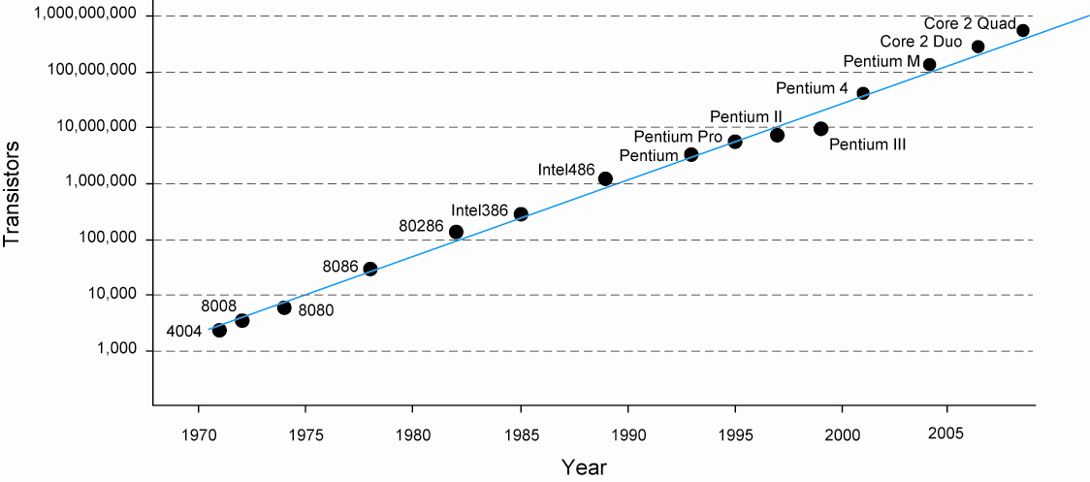
And Now…

Slide 11
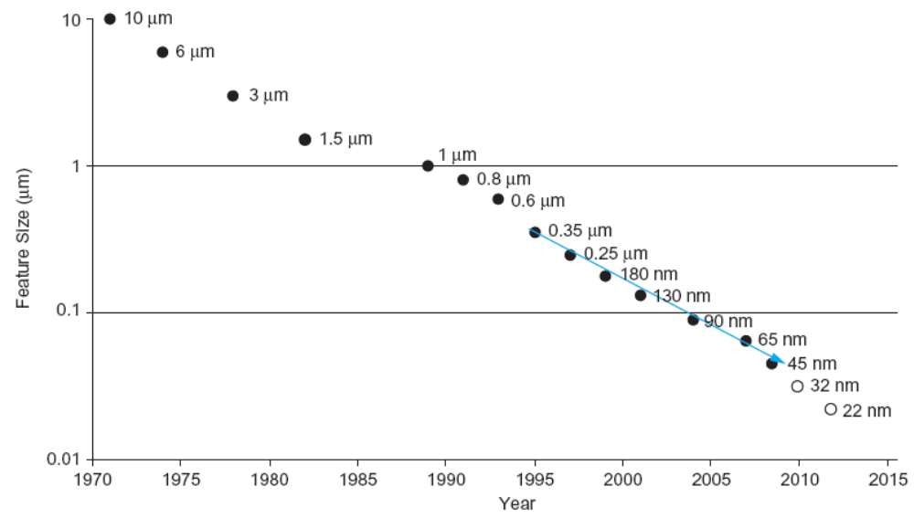
Feature Size
Minimum feature size shrinking 30% every 2-3 years

Slide 12
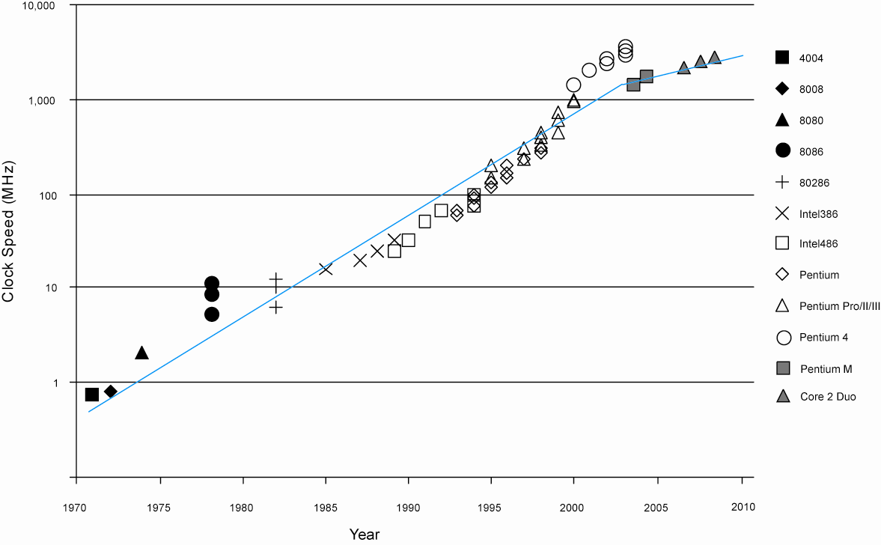
Corollaries
Many other factors grow exponentially
  Ex: clock frequency, processor performance

Slide 13
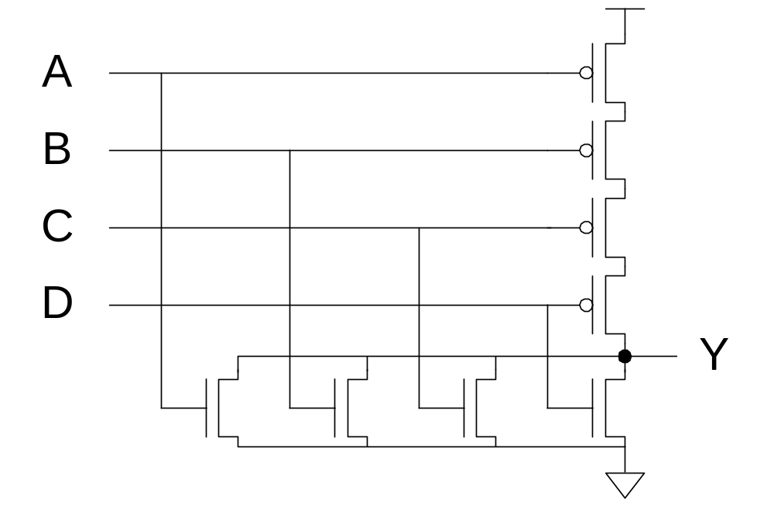
CMOS Gate Design
Activity:
  Sketch a 4-input CMOS NOR gate

Slide 14
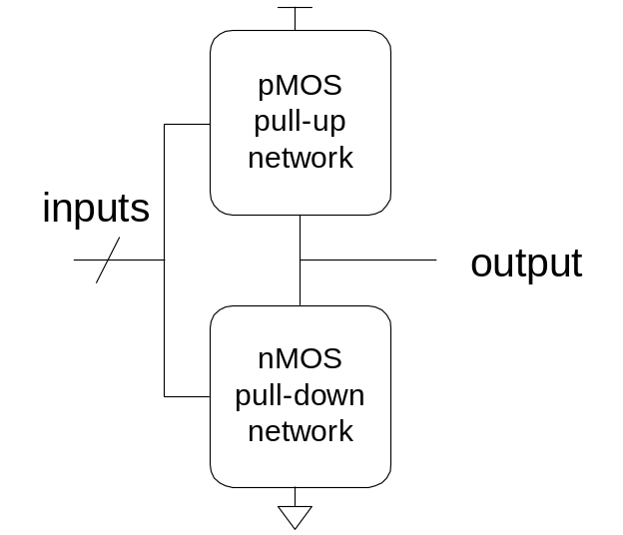
Complementary MOS
Complementary CMOS logic gates
  nMOS pull-down network
  pMOS pull-up network
  a.k.a. static CMOS
 | Pull-up OFF | Pull-up ON
Pull-down OFF | Z (float) | 1
Pull-down ON | 0 | X (crowbar)
Notes:
When both pull-up and pull-down are OFF, the high impedance or floating Z output state results. This is of importance in multiplexers, memory elements, and tri-state bus drivers.
The crowbarred (or contention) X level exists when both pull-up and pull-down are simultaneously turned ON. Contention between the two networks results in an indeterminate output level and dissipates static power. It is usually an unwanted condition.

Slide 15
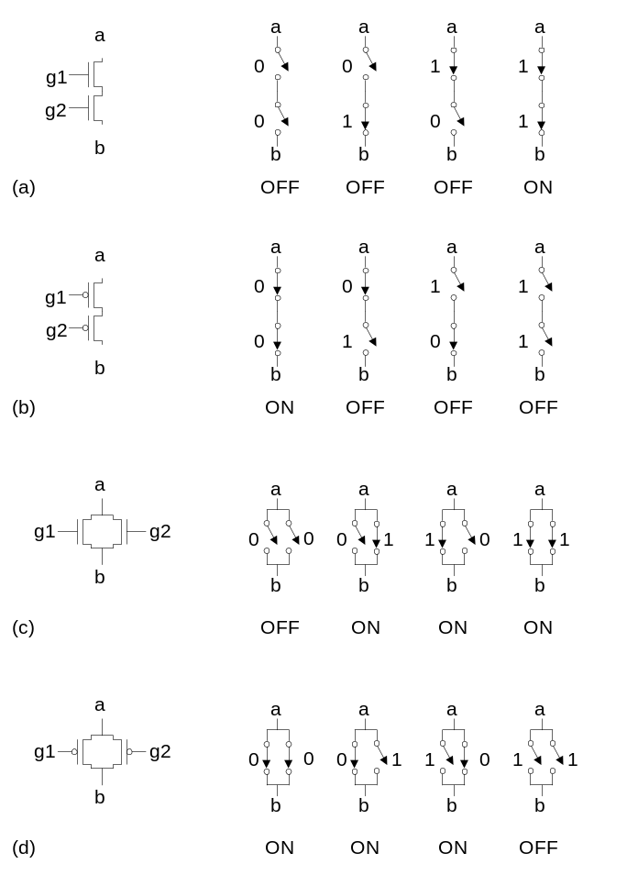
Series and Parallel
nMOS: 1 = ON
pMOS: 0 = ON
Series: both must be ON
Parallel: either can be ON

Slide 16
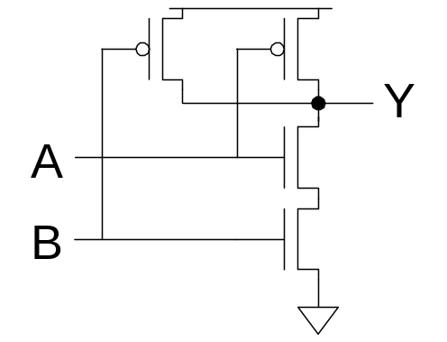
Conduction Complement
Complementary CMOS gates always produce 0 or 1
Ex: NAND gate
  Series nMOS: Y=0 when both inputs are 1
  Thus Y=1 when either input is 0
  Requires parallel pMOS
Rule of Conduction Complements
  Pull-up network is complement of pull-down
  Parallel -> series, series -> parallel
Notes:
Like nMOS, in the pMOS pull-up network, we must compute the complementary expression using switches that turn on with inverted polarity. By DeMorgan’s Law, this is equivalent to interchanging AND operations and OR operations. Hence, transistors that appear in series in the pull-down network must appear in parallel in the pull-up network. Transistors that appear in parallel in the pulldown network must appear in series in the pull-up network. This principle is called conduction complements.

Slide 17
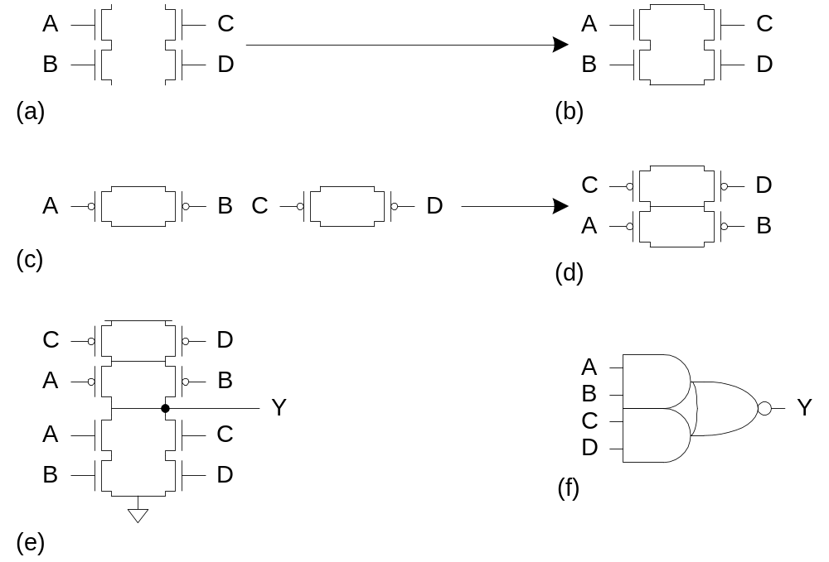
Compound Gates
Compound gates can do any inverting function
Ex:
Notes:
A compound gate performs a more complex logic function in a single stage of logic is formed by using a combination of series and parallel switch structures.

Slide 18
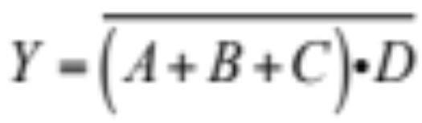
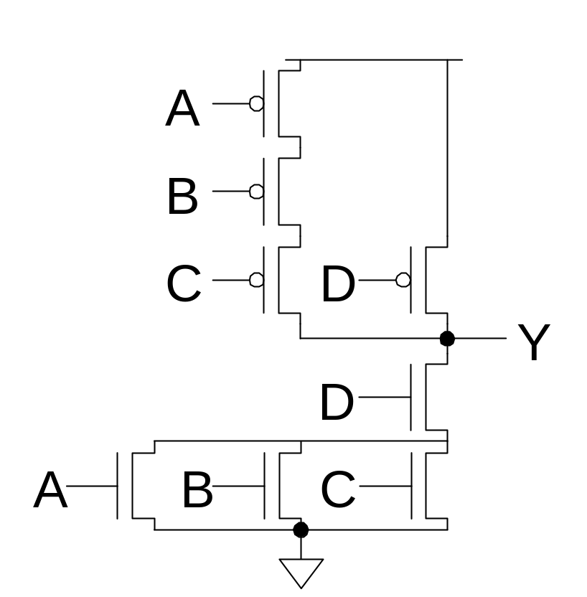
Example: O3AI

Slide 19
Signal Strength
Strength of signal
  How closely it approximates ideal voltage source
V_{DD} and GND rails are strongest 1 and 0
nMOS pass strong 0
  But degraded or weak 1
pMOS pass strong 1
  But degraded or weak 0
Thus nMOS are best for pull-down network

Slide 20
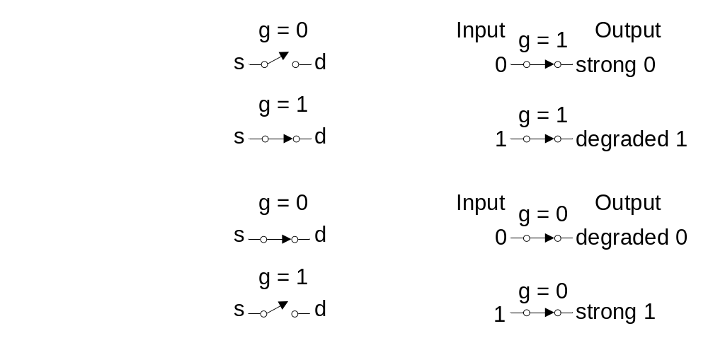
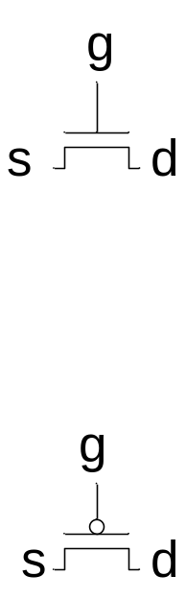
Pass Transistors
When an nMOS or pMOS is used alone as an imperfect switch, It’s called Pass Transistor.

Slide 21
Transmission Gates
Combining nMOS & pMOS in parallel, a switch is obtained
It turns on when a High voltage or 1 is applied at the gate
Remains closed when 0 is applied
Both 0s and 1s are passed in an acceptable manner
This combination is called transmission gate

Slide 22
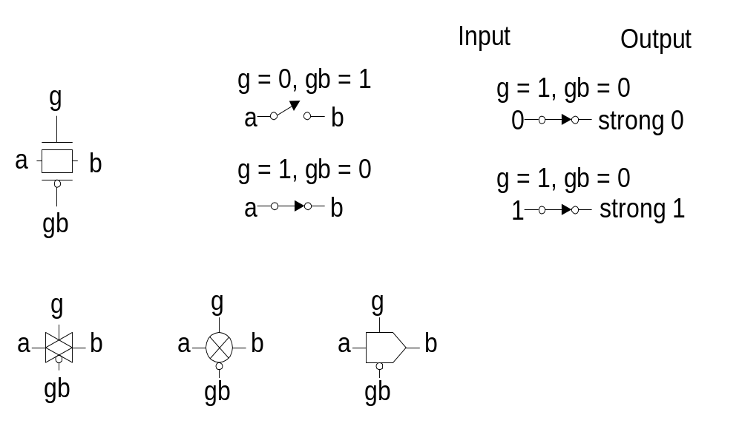
Transmission Gate

Slide 23
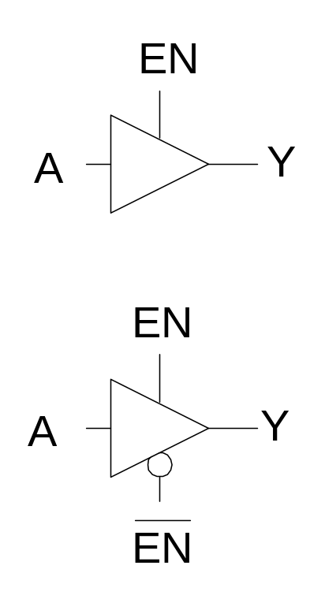
Tristates
Tristate buffer produces Z when not enabled
Otherwise, passes A to Y
EN | Input | Output
0 | 0 | Z
0 | 1 | Z
1 | 0 | 0
1 | 1 | 1

Slide 24
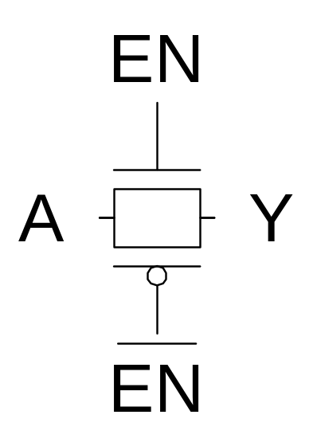
Nonrestoring Tristate
Transmission gate acts as tristate buffer
  Only two transistors
  But nonrestoring
    Noise on A is passed on to Y

Slide 25
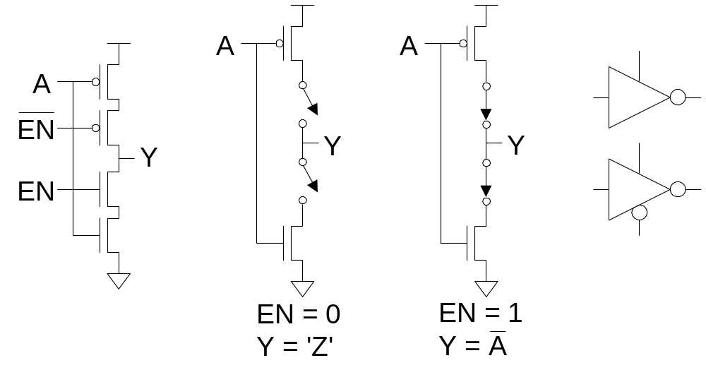
Tristate Inverter
Output actively driven from V_{DD} or Ground
Restoring logic gate, no noise is passed
Violates conduction complement by allowing Z

Slide 26
Tristate Usage
Allow multiple unit for a common bus
At least one enabled unit can run it
More than one unit enabled causes contention
Static power is dissipated
When no unit is enabled, floats to invalid logic level
Power is wasted in invalid level
Due to these complexity, Multiplexers are preferred

Slide 27
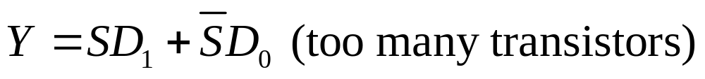
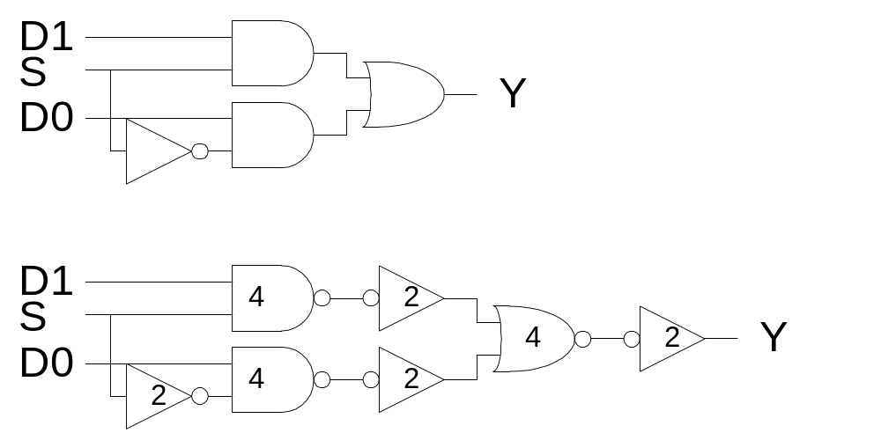
Gate-Level Mux Design
How many transistors are needed? 20

